Slide 1
Experiment No. 12
Problem Definition:
Suppose writer process generates data to be consumed by a reader process on the same machine. Develop a suitable inter process communication mechanism between the two processes that allows not just for one-time but also at subsequent times during execution.
CSE@GIT
6/1/2017
Department of Computer Science and Engineering, GIT

Slide 2
Objectives of the Experiment:
1) To familiarize with creation of FIFO file
2) To understand how the inter process communication takes place between two processes
CSE@GIT
6/1/2017
Department of Computer Science and Engineering, GIT

Slide 3




Server
FIFO1
FIFO2
Client

Slide 4
Theoretical Background of the Experiment
FIFO - These are special device files used for inter process communication
These are also known as named pipes
Data written to a FIFO file are stored in a fixed-size buffer and retrieved in a first-in-first-out order
To create:
int mkfifo( const char* path_name, mode_t mode);
mkfifo("FIFO1", 0666);

Slide 5
How is synchronization provided?
When a process opens a FIFO file for read-only, the kernel will block the process until there is another process that opens the same file for write
If a process opens a FIFO for write, it will be blocked until another process opens the FIFO for read
This provides a method for process synchronization

Slide 6
How is synchronization provided?
If a process writes to a FIFO that is full, the process will be blocked until another process has read data from the FIFO to make room for new data in the FIFO
If a process attempts to read data from a FIFO that is empty, the process will be blocked until another process writes data to the FIFO

Slide 7
How is synchronization provided?
If a process writes to a FIFO file that has no other process attached to it for read, the kernel will send a SIGPIPE signal to the process to notify it of the illegal operation
If Two processes are to communicate via a FIFO file, it is important that the writer process closes its file descriptor when it is done, so that the reader process can see the end-of-file condition

Slide 8
Usage
Uses of the fd argument are:
Server Side
readfd is a file descriptor to read data from the FIFO1 file
writefd is a file descriptor to write data to a FIFO2 file
Client Side
writefd is a file descriptor to write data to a FIFO1 file
readfd is a file descriptor to read data from the FIFO2 file

Slide 9
Important system calls
open, read, write, close
  open: Open or create a FIFO
  read: Read from a FIFO
  write: Write data to a FIFO
  close: Close/destroy FIFO

Slide 10
Flow of implementation :
Declare required header files unistd.h, stdio.h
Create the two FIFO files for two processes called FIFO1 & FIFO2
In server side open the file descriptor FIFO1 for read and FIFO2 for write
In client side open the file descriptor FIFO1 for write and FIFO2 for read
Client side ,it enters the file name from user and write content into the FIFO1, server side opens the FIFO1 and reads the content of FIFO1
6/1/2017
Department of Computer Science and Engineering, GIT

Slide 11
Flow of implementation :
6. Server opens the file mentioned in content and writes the contents into the FIFO2 file then closes the file descriptors
7. Client side , will read the content from FIFO2, and displays the read content onto the standard output then close the file descriptors
6/1/2017
Department of Computer Science and Engineering, GIT

Slide 12
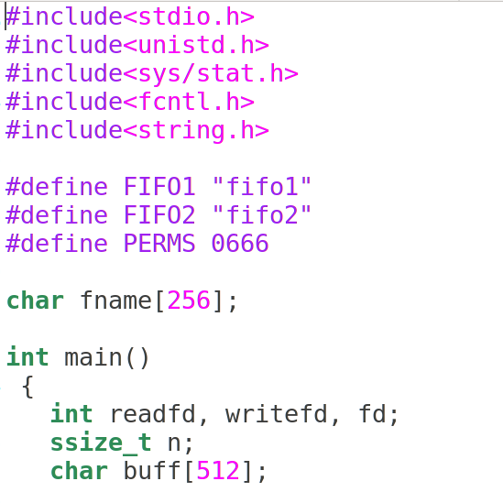
Pseudo Code / Outline of the Algorithm
Server.c
6/1/2017
Department of Computer Science and Engineering, GIT

Slide 13
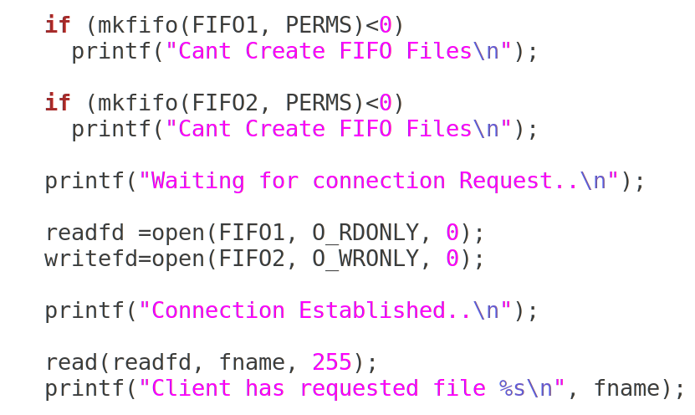
Pseudo Code / Outline of the Algorithm
Server.c
6/1/2017
Department of Computer Science and Engineering, GIT

Slide 14
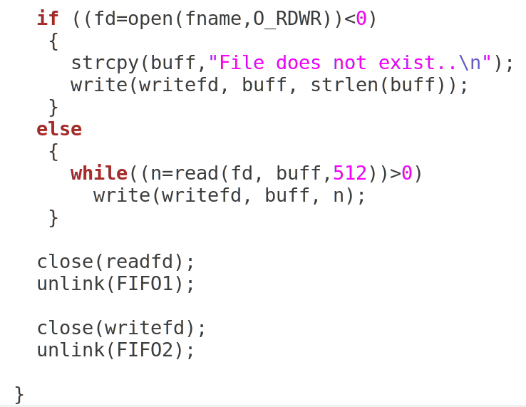
Pseudo Code / Outline of the Algorithm
6/1/2017
Department of Computer Science and Engineering, GIT

Slide 15
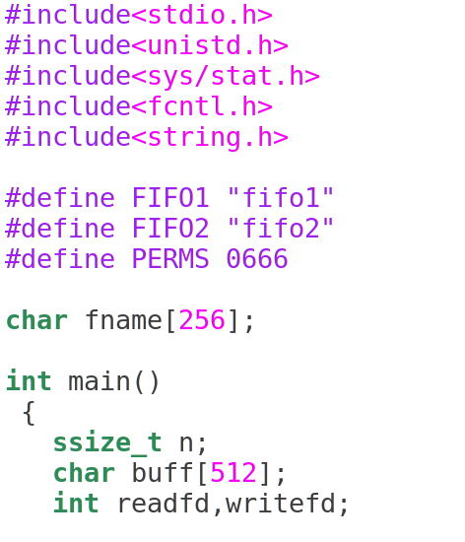
Pseudo Code / Outline of the Algorithm
Client.c
6/1/2017
Department of Computer Science and Engineering, GIT

Slide 16
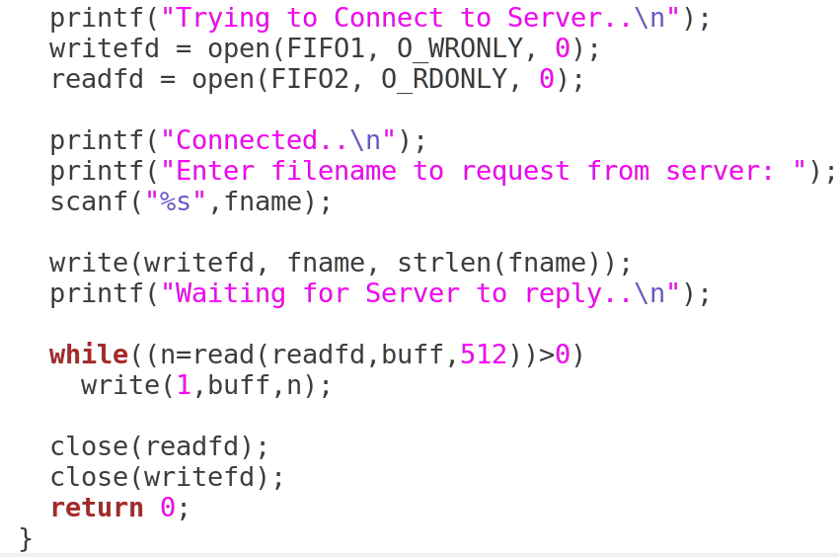
Pseudo Code / Outline of the Algorithm
Client.c
6/1/2017
Department of Computer Science and Engineering, GIT

Slide 17

Output (Server)
[root@localhost USP Lab] ./a.out
Waiting for connection Request..
Connection Established..
Client has requested file 1.c
[root@localhost USPLab]
Output (Client)
[root@localhost USPLab] ./a.out
Trying to Connect to Server..
Connected..
Enter the filename to request from server:1.c
Waiting for Server to reply..
Hi Welcome to USP Lab.
Now End of file
6/1/2017
Department of Computer Science and Engineering, GIT

Slide 18
Learning Outcomes of the Experiment
At the end of the session, students should be able to :
1) Understand creating the FIFO file[L2].
2) Understand how the interaction takes place between two processes using FIFO[L2].
6/1/2017
Department of Computer Science and Engineering, GIT

